Slide 1

Info Sec Transience Identifying Ephemeral Security Assets with Machine Learning
CDG Security
Daniel Tetrick

Slide 2
Why is Asset Inventory Important? You can’t protect what you don’t know you have!
The ability to track and audit asset inventory is a requirement for many security standards, including the CIS, HIPAA, and PCI.
When a security event happens, you need to know who to identify as the owner to begin remediation.
A strong asset inventory system allows you to support functions such as incident response, hunt, detections, analysis and machine learning

Slide 3
What is secure from birth?
Secure from Birth is a CDG Security initiative to ensure all assets in their inventory are created with monitoring and scanning installed – assuring optimal security cradle to grave for our customers.
A major issue many security teams face when attempting to protect their inventory is ephemeral or transient assets.
BUSINESS CASE: Identify customer services creating unmonitored transient assets and work with them to get their assets secure from birth by adjusting their business processing, image creation, etc…
Notes:
This is a template you can use on other security services.
On a high level we can use this approach in the following application….

Slide 4
What are Transient Assets?
Transient or ephemeral security assets are observed in inventory data for a short amount of time and then disappear from the data source. They create three major challenges to the goal of optimal security:
More Vulnerable
Inaccurate / Misrepresent Reporting
Loss of Credibility and Productivity
CDG Security works with its inventory management system to provide a life-span value for each security asset, then tracks the asset’s behavior to allow security teams the ability to process ephemeral assets per their business requirements.
Notes:
1. Assets do not exist long enough to trigger security monitoring and scanning onboarding processes – thus do not get onboarded before they disappear. More Vulnerable
2. Assets can misrepresent or introduce fluctuations to our aggregate security metric calculations for Security Fundamentals, Monthly Scorecard, and other reporting. Inaccurate Reporting
3. Assets create S360 Ghost actions for our partners. The asset doesn’t exist when it is time for it to be serviced causing partners to lose time and efficiency on a problem that no longer exists. Loss of Credibility and Productivity

Slide 5
What are Durable Assets?
Durable security assets can be observed in inventory data over a longer time period and are less susceptible to the challenges facing ephemeral assets.
A sample analysis of CDG security assets revealed that 3-days is an appropriate life-span to define the transient or durable classification. Assets appearing in the data for over 3-days are considered durable.
Each security business will need to analyze their inventory’s transient and durable threshold independently.

Slide 6
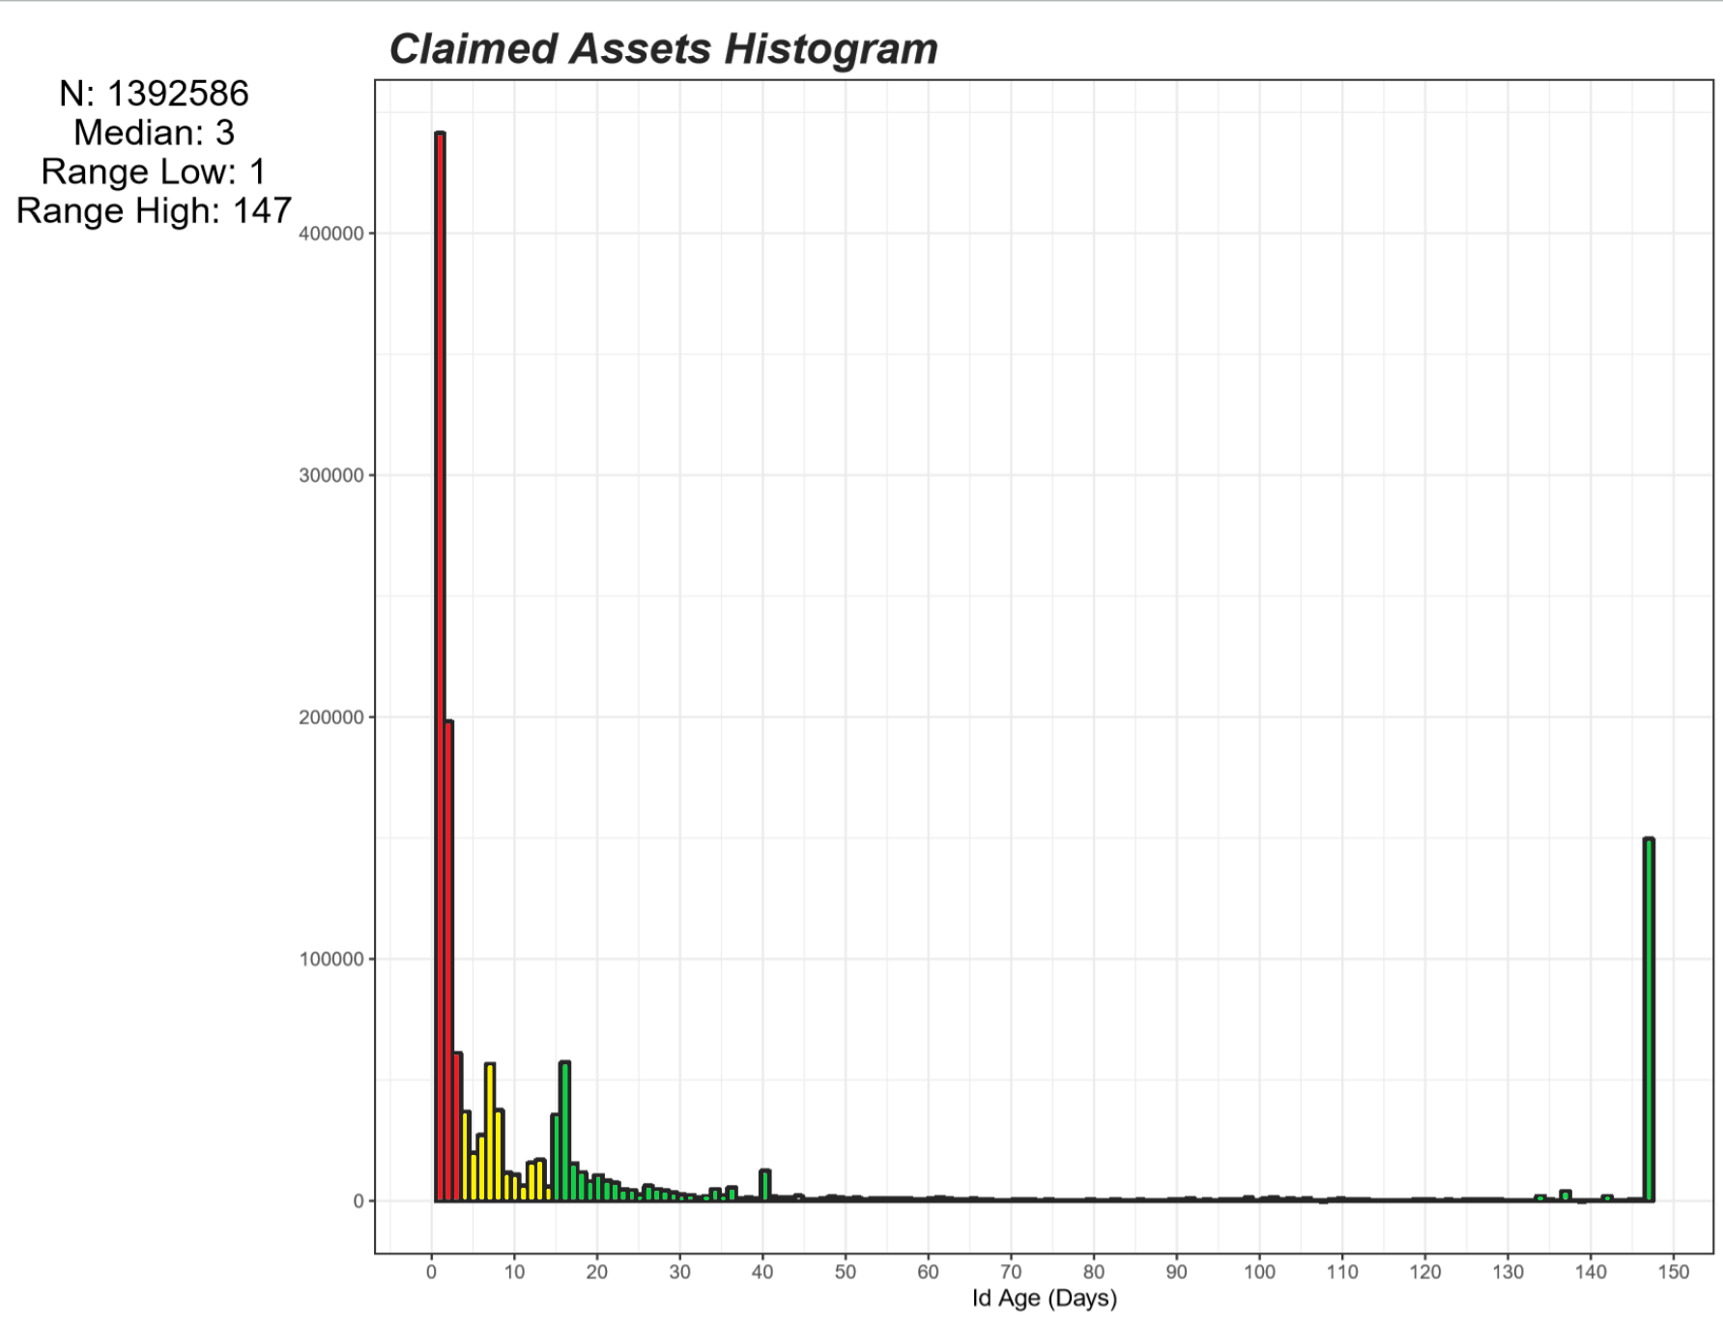
Transient Analysis
Id Age measures the number of days between the first and last date each asset was observed in your inventory .
50%
Overall, 1.4M Claimed assets were found over a 147-day study.
Over 701K (50%) were Transient and did not age past 3-days.
32%
18%
Only 411K (32%) were in the data over 14-days.
Notes:
Id Age over a 147-day study of claimed assets in the Conflux data platform.
Overall, the analysis found nearly 1.4M unique assets with a median age of 3-days.
Over 701K (50%) of all assets did not live past an Id Age of 5 days age are considered transient (red).
Only 311K (32%) of assets lived past 14-days age (green) and are considered durable.
The yellow area (18%) of the histogram is under further analysis.

Slide 7
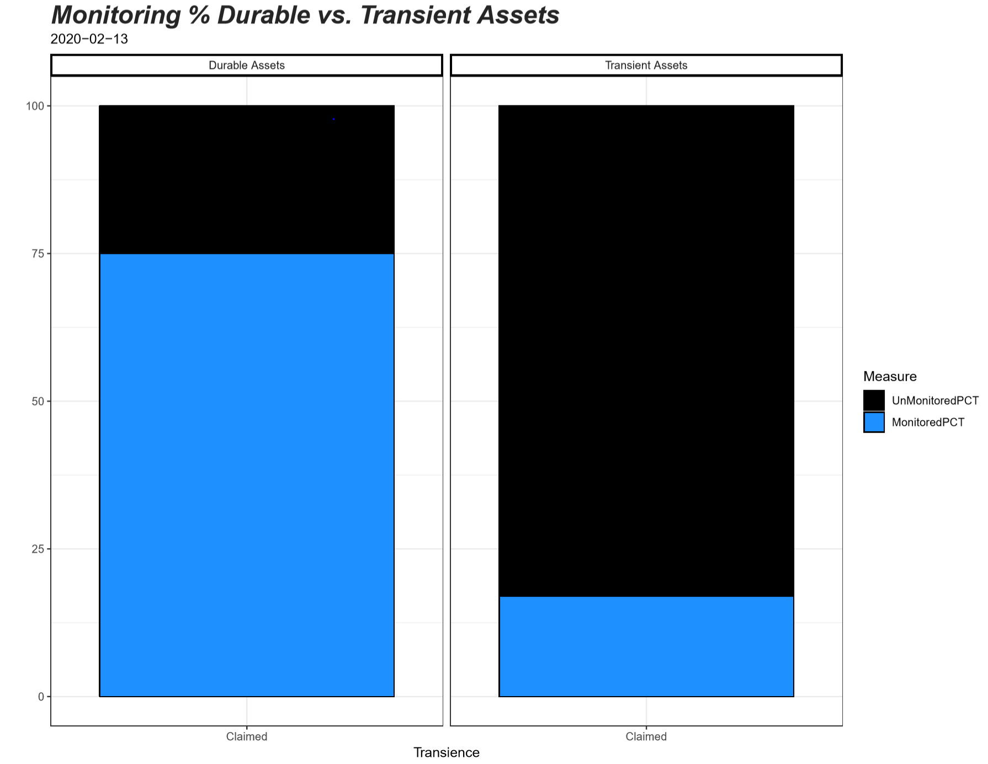

Why It Matters?
Monitoring and Scanning % are significantly different when comparing Durable and Transient assets.
Total > 3 Days: 143K
Total <= 3 Days: 7.4K
Segmenting assets by an Id Age of <= 3 days reveals a 58% difference in Monitoring. (~same for Scanning)
-58%
Durable assets are monitored 75% of the time, whereas Transient assets are only monitored 17% of the time.
Monitored Durable
108K (75%)
Monitored Transient
1.2K (17%)
Notes:
We have 251K total assets we report (isclaimed ==1)
29K (11.7%) of reported assets are considered potentially Transients
6,400 (only 22%) of the 29K are monitored securely
222K (88%) of reported assets are Durable
180K (81%) of those are monitored
A 59% difference in monitoring performance exists based on the analysis.
The same difference exists for scanning but was deprecated for space. The results are in the appendix

Slide 8
Binary Classifier
Input data streams from Inventory are processed in Azure Data Lake (ADL)
To give CDG Security insight into which new assets entering their inventory will be transient, a binary classifier machine learning model is created.
Processed inventory data is ingested into Databricks Notebooks
Databricks Notebook
Data is parsed into 3 data sets for modeling:
1. ToPredict – New Assets need predictions
2. ToTrain – Random 70% Sample to Train Model
3. ToTest – Random 30% Sample to Test Model
ToTrain and ToTest
ToPredict
Light GBM Classifier
An LightGBM classifier predicts new assets transient probability
Predictions are sent to the Data Store
Predictions to Data Store
Notes:
If we look at each XDivAsset id’s age historically (35 days) we see that a large proportion of all assets don’t live past the 3 day age range.
If we look at a 3 day time line we see 42% of all assets die

Slide 9
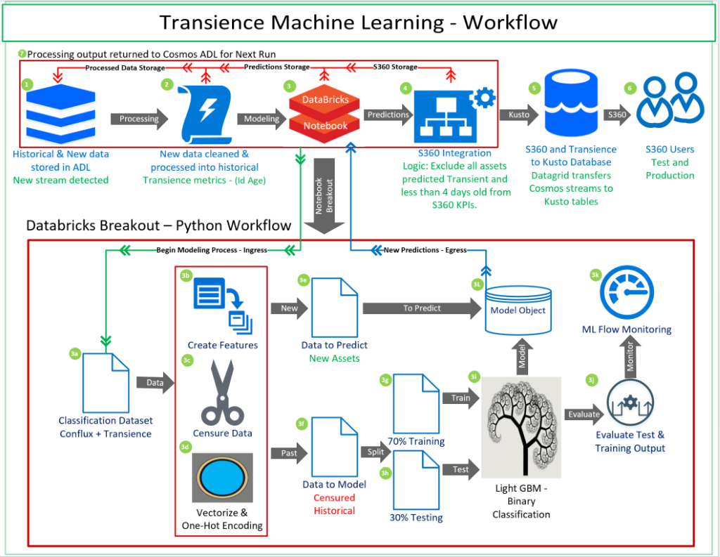
Notes:
All historical and new data is stored in Cosmos ADL as structured streams. When a new stream event is detected the machine learning process begins by unioning the new stream set to the previous collected streams.
New data streams are cleaned and formatted to match the previous historical stream sets, allowing a complete history of which assets are and are not available each day. Transience metrics track asset behavior beginning on the first date seen and ending on the last date it was seen in the data. The Id Age variable created is the key metric used for binary classification and measures the number of days between the first and last date each asset was seen.
After processing, the data is available for machine learning and analysis. The Databrick’s notebook process begins using an internal job scheduler. The Databricks section is intentionally broken out to display the inner workings of the notebook logic and sequencing.
The classification dataset consists of all assets in the historical data set as seen on its 1st day. This allows accurate predictions to be created for new assets (1st day) as they enter the data.
Features such are created and added to the classification data.
Data is censured to remove datapoints that haven’t been in data long enough to become transient or were in the data prior to the project beginning. Censuring prevents illegitimate data points from entering the training data and creating confusion.
Categorical variables are vectorized and then one-hot encoded. This process creates numeric values out of text values so that they can be easily used in modeling. The binary variables are also added to the overall data model at this point.
Data to predict upon are filtered out of the overall classification so they are not included in the training data. Prediction data points are defined as new assets, or assets that have not been seen in the historical data set previously.
Data to model are the remaining censured data points with predictions removed. This data represents he cleaned model data that is best suited to build the binary classifier.
70% of the data to model is randomly sampled and will be used to train the Light GBM classifier.
The remaining 30% of the data is held aside from model training and will be used to cross-validate the accuracy of the model.
Light Gradient Boosted Model (GBM) – is a gradient boosting framework that uses tree-based learning algorithms.
Model evaluation using the Training and Test data is done with the Area Under the Curve (AUC) and the Area Under the Precision Recall Curve to verify there is not drift between the test and training data sets.
Databricks ML Flow is used for Monitoring model output and saving the evaluations.
S360 data models integrate Transience predictions and metrics into existing cook jobs and apply the dynamic exclusion logic. Logic entails excluding any asset that is predicted to be transient and is not greater than 3-days old.
Datagrid transfers S360 w/ transient exclusions data streams from Cosmos ADL into Kusto data tables.
S360 production and development uses Kusto data tables as inputs into their UI. Transient assets are excluded in the previous steps so that they do not surface in the UI for partners to act.
As processing occurs, the outputs are sent to the next step in the ML pipeline and a copy of the data sent is stored in Cosmos ADL for further processing.

Slide 10
Transience Databricks Notebook
CLICK ICON

Slide 11
FUTURE STATE
Integrate Microsoft-wide inventory data platform (700M assets) as the source for transient methodology. This will allow all MSFT security teams to leverage the analysis and machine learning to handle ephemeral assets per their requirements.
Include a prediction of asset life-span (continuous numerical variable) w/ intervals to allow for users to incorporate more in-depth insights into their business.

Slide 12
Next steps
Transition data source to Microsoft-wide inventory data platform
Identify new ways to leverage transience as the lead indicator for the Secure from Birth initiative.
Research paper publication
MLADS presentation
Red Team leveraging Transience data
Expand data science tech and tools to other security problems.

Slide 13
Q&A

